Slide 1

JAWAHARLAL NEHRU TECHNOLOGICAL UNIVERSITY HYDERABAD
UNIVERSITY COLLEGE OF ENGINEERING MANTHANI
Centenary Colony(Po), Pannur (Vill), Ramagiri (Mdl), Peddapalli, Telangana-505212, India
Department of Computer Science and Engineering
An AI-Enabled Interview Simulation and ATS-Compatible Resume System for Career Readiness
Under the guidance of:
Dr. B. Vishnu Vardhan
Senior Professor,
Computer Science and Engineering,
Principal of JNTUH UCEM.
Team Members:
Akula Sandeep Kumar | 22VD1A0548
Cheekati Ramya | 22VD1A0542
Madduri Sreeja | 22VD1A0556
Medini Bharath | 22VD1A0508
Kummari Naveen | 22VD1A0530

Slide 2

Contents
  Introduction
  Abstract
  Existing System
  Limitations of Existing System
  Problem Statement
  Proposed System
  Advantages of Proposed System
  Software Requirements Specifications
  System Design
  Implementation
  Result
  Conclusion

Slide 3
Introduction
  An AI-Enabled Interview Simulation and ATS-Compatible Resume System designed for career readiness.
  Securing a job today is not just about qualifications, but also about presentation and preparedness.
  Many candidates fail due to poor interview performance or non-ATS-compliant resumes.
  Traditional tools are generic, repetitive, and lack real-time feedback.
  The system combines automated resume screening with AI-based interview simulation.
  Utilizes locally trained AI models without external APIs or third-party services.
  Implements Q-Learning–based intelligent agents for adaptive decision-making.
  Provides personalized, adaptive feedback to improve career readiness and selection chances.
  Helps candidates overcome challenges in interviews and resume shortlisting.

Slide 4
Abstract
  Job seekers face challenges in the recruitment process due to lack of preparation, low confidence, and unfamiliarity with role-specific questions.
  Many resumes are automatically rejected by ATS because of poor formatting, missing keywords, or improper structure.
  The platform employs a multi-agent framework consisting of one Q-Learning interview agent and three ATS decision agents.
  The Interview Module evaluates correctness, fluency, tone, and non-verbal cues.
  The Resume Module analyzes formatting, keyword relevance, and ATS compliance also the Resume Builder module will help the user to create the ATS friendly resume using Latex editor.
  Resume Agent extracts text, applies TF-IDF, BM25, and SBERT to check keyword relevance and semantic similarity, then generates ATS score with suggestions.
  Interview Agent uses ASR to convert speech to text, applies NLP for correctness, fluency, and tone, and Deep Learning (CNN + MediaPipe) for facial expressions and posture.

Slide 5
Existing System
  The existing systems for interview preparation and ATS resume building encompass a variety of platforms and tools currently available in the market. Some notable examples include:
  Remasto – Offers AI mock interviews and resume builder features, but interview evaluation remains limited to predefined structures and lacks detailed semantic analysis, role-based keyword mapping, and deep ATS-driven formatting intelligence.
  Pramp – Provides peer-to-peer mock interviews but lacks adaptive AI feedback and does not evaluate tone, fluency, or non-verbal communication.
  InterviewBuddy – Offers live interviews with experts, yet the evaluation is generic, human-dependent, and not scalable for large numbers of candidates.
  HireVue – Applies AI to video interviews, analyzing speech and facial expressions, but the system is employer-centric and candidates receive little actionable feedback.
  VMock Resume Analyzer – Produces ATS scores and improvement suggestions, but feedback remains limited, generic, and non-adaptive.

Slide 6
Limitations of Existing System
  Interview platforms are generic, asking repetitive questions without adapting to candidate profiles or job roles.
  Lack of real-time, personalized feedback on correctness, fluency, tone, expressions, or gestures.
  Resume builders emphasize templates and design, neglecting ATS compliance and recruiter requirements.
  ATS tools rely on surface-level keyword matching without semantic similarity or contextual analysis.
  Feedback from existing systems is often static and non-adaptive, providing the same suggestions to all users.
  Existing systems do not provide a holistic approach that prepares candidates for both interviews and resume screening.
  Non-verbal communication (facial expressions, eye contact, posture) is largely ignored in most interview simulators.

Slide 7
Problem Statement
  Traditional recruitment systems often reject capable candidates, not due to lack of skills, but because of poor interview performance and non-ATS-compliant resumes. Interviews are hindered by low confidence and lack of preparation, while resumes fail ATS checks for missing keywords and improper formatting. Existing tools are generic and lack personalized, real-time feedback.
  We propose an AI-enabled Interview Simulation and ATS-Compatible Resume System that combines NLP, Deep Learning, and ML models to form an AI agent to deliver personalized feedback, optimize resumes, and improve selection chances.

Slide 8
Proposed System​
  The proposed system follows a three-tier architectural model consisting of presentation, API, and data persistence layers.
  The presentation layer is developed using React 19 with TypeScript, while the backend is implemented using Next.js 16 RESTful services, with PostgreSQL and Prisma ORM for persistent storage.
  The interview process is managed by a dedicated Q-Learning–based Interview Agent operating over 87,846 discrete states, considering technical knowledge, experience, education, communication, confidence, and cultural fit.
  The Interview Agent employs an ε-greedy policy (75% exploitation, 25% exploration) and supports real-time adaptive questioning with over 2.5 billion possible question combinations.
  The ATS recruitment process is executed through a collaborative multi-agent framework consisting of three specialized AI agents.
  The Resume Analysis Agent performs NLP-based feature extraction including skills, experience, semantic relevance, and cultural indicators, using a technology vocabulary exceeding 1000+ domain terms.
Proposed System

Slide 9
  The Q-Learning Hiring Agent evaluates candidate profiles using a reinforcement learning model with 1.7 million state combinations, producing decisions such as Hire, Reject, or Consider with an observed accuracy of 94.7%.
  The Intelligent Neural Network Agent acts as a secondary decision system, providing pattern recognition, continuous learning, and explainable validation of hiring outcomes.
  All ATS agents operate collaboratively, synthesizing their outputs to generate a final unified recruitment recommendation.
  Supporting technologies include MediaPipe-based facial expression analysis, speech transcription services, secure cloud storage, and security middleware for CSRF, XSS, and rate limiting protection.Interview Performance Report
  The system maintains 11 normalized relational data models with enforced referential integrity, cascading rules, and version-controlled audit tracking.

Slide 10
Advantages of Proposed System
  Provides a unified platform for interview simulation, ATS-based resume optimization and Resume builder.
  Delivers personalized, adaptive, and real-time feedback instead of generic evaluations.
  Achieves interview question generation latency below 10 milliseconds, delivering nearly 100× faster performance compared to cloud-based AI services.
  Completes resume analysis within 500 milliseconds and generates interview reports in under one second.
  Operates without any external AI API dependency, ensuring offline capability and complete algorithmic control.
  Generates over 2.5 billion unique interview question combinations, eliminating repetition through parametric construction.
  Dynamically adapts question difficulty and role specificity based on candidate performance using Q-Learning.
  Increases the chances of resume shortlisting and successful interview performance.
  Supports role-specific and job-oriented evaluation based on provided job descriptions.

Slide 11
Software Requirements Specifications
  Software Requirements
    Programming Languages:
      Python (core development, AI/ML/NLP models)
      JavaScript, React.js, TypeScript, Next.js, CSS3 (for responsive UI, frontend development, API layer and backend services)
    Frameworks and Libraries:
      NLP: BERT, SBERT, Transformers (HuggingFace), TF-IDF, BM25
      Deep Learning: TensorFlow / PyTorch
      Computer Vision: OpenCV, MediaPipe, CNN models
      Machine Learning: Scikit-learn (Random Forest, Regression, Reinforcement Learning)
      Speech Processing: SpeechRecognition, PyDub, Whisper
    APIs and Services:
      HuggingFace Inference Endpoints

Slide 12
      JWT-based authentication services
      AWS S3 cloud storage
    Database:
      SQLite / PostgreSQL (for storing resumes, interview results, reports, and user data)
    Datasets:
      Resume Dataset: Kaggle Resume Dataset (resume parsing & ATS evaluation).
      Job Description Dataset: Job postings dataset (LinkedIn/Indeed crawled data).
      Interview QA Dataset: Public technical & HR interview question-answer datasets.
      Speech Dataset: LibriSpeech, Mozilla Common Voice (for ASR training/testing).
      Facial Expression Dataset: FER2013, AffectNet, MediaPipe landmark data (for non-verbal cue analysis).
    Windows 10 / 11 (64-bit)

Slide 13
  Hardware Requirements
    Processor – Intel Core i5 (8th Gen) / AMD Ryzen 5.
    Graphical Processing Unit (GPU) – NVIDIA RTX 3060 / 3080 (for deep learning, CNN, MediaPipe models).
    RAM – 8GB or above.
    Storage / ROM – 512GB SSD or above.
    Peripherals – HD Camera, Microphone.

Slide 14
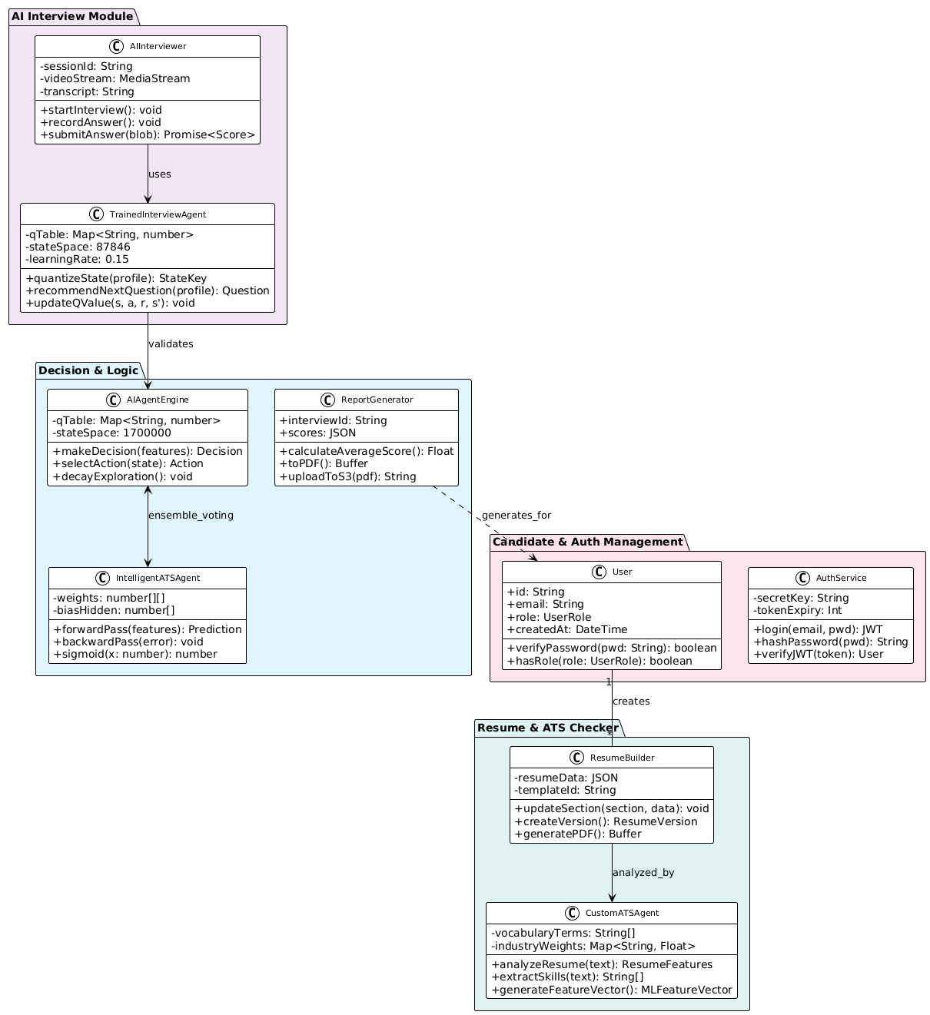
System Design
  Class Diagram:

Slide 15
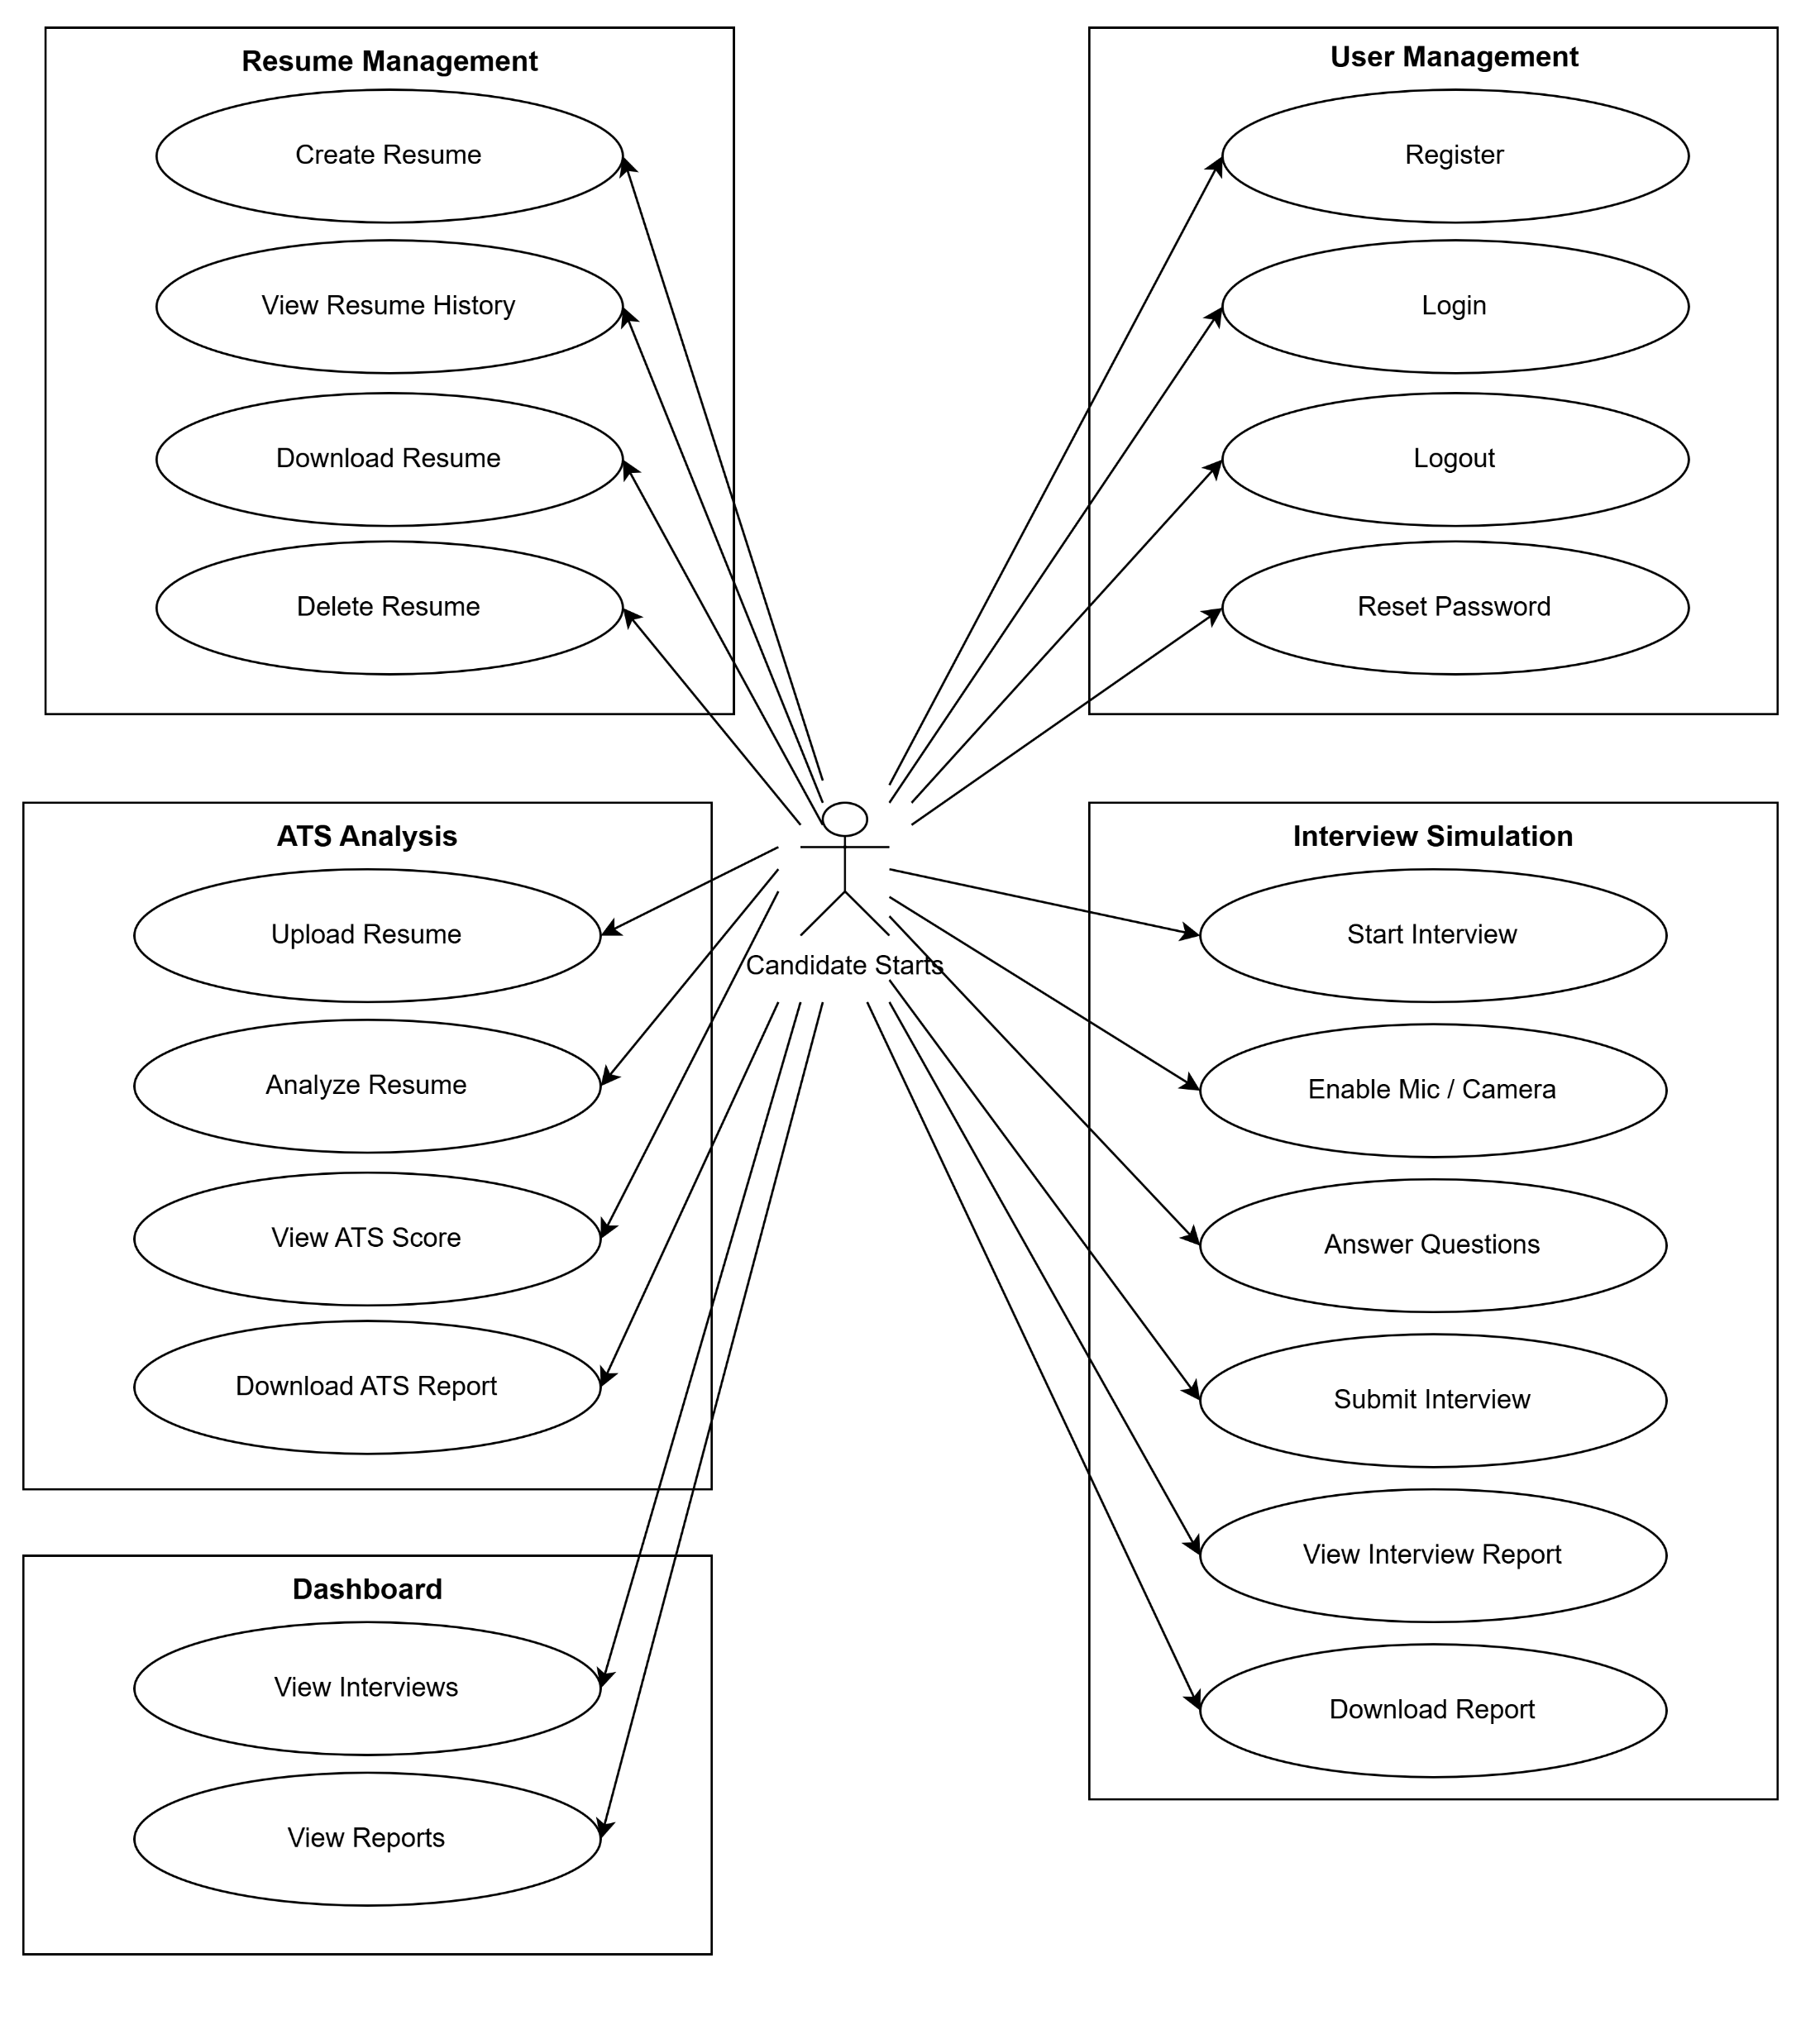
  Use Case Diagram:
  User Use Case Diagram:

Slide 16
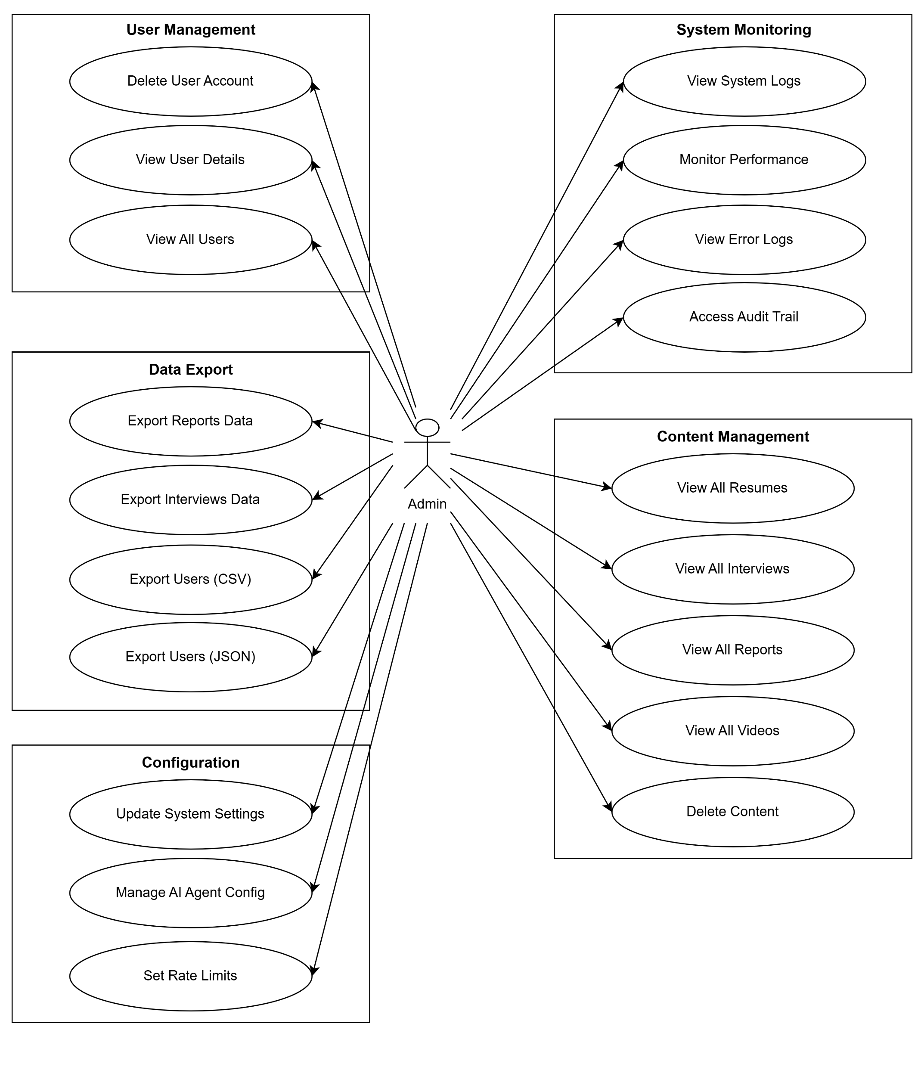
  Admin Use Case Diagram:

Slide 17
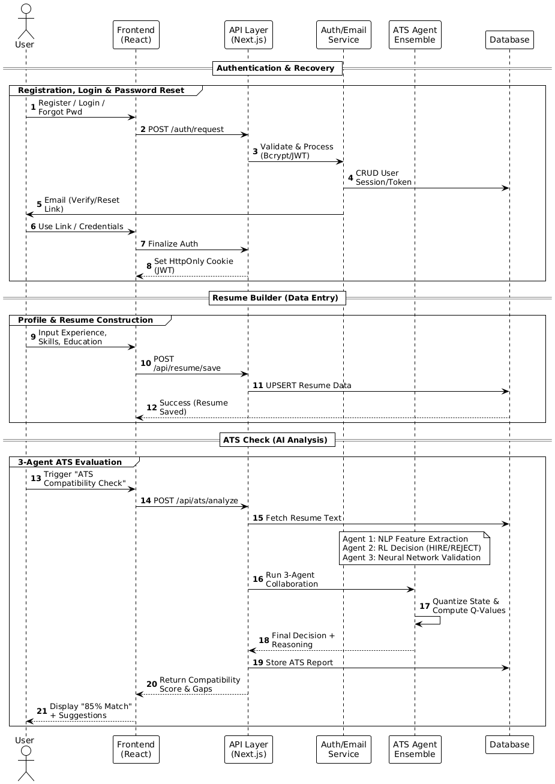
  Sequence Diagram:
  User Sequence Diagram:

Slide 18
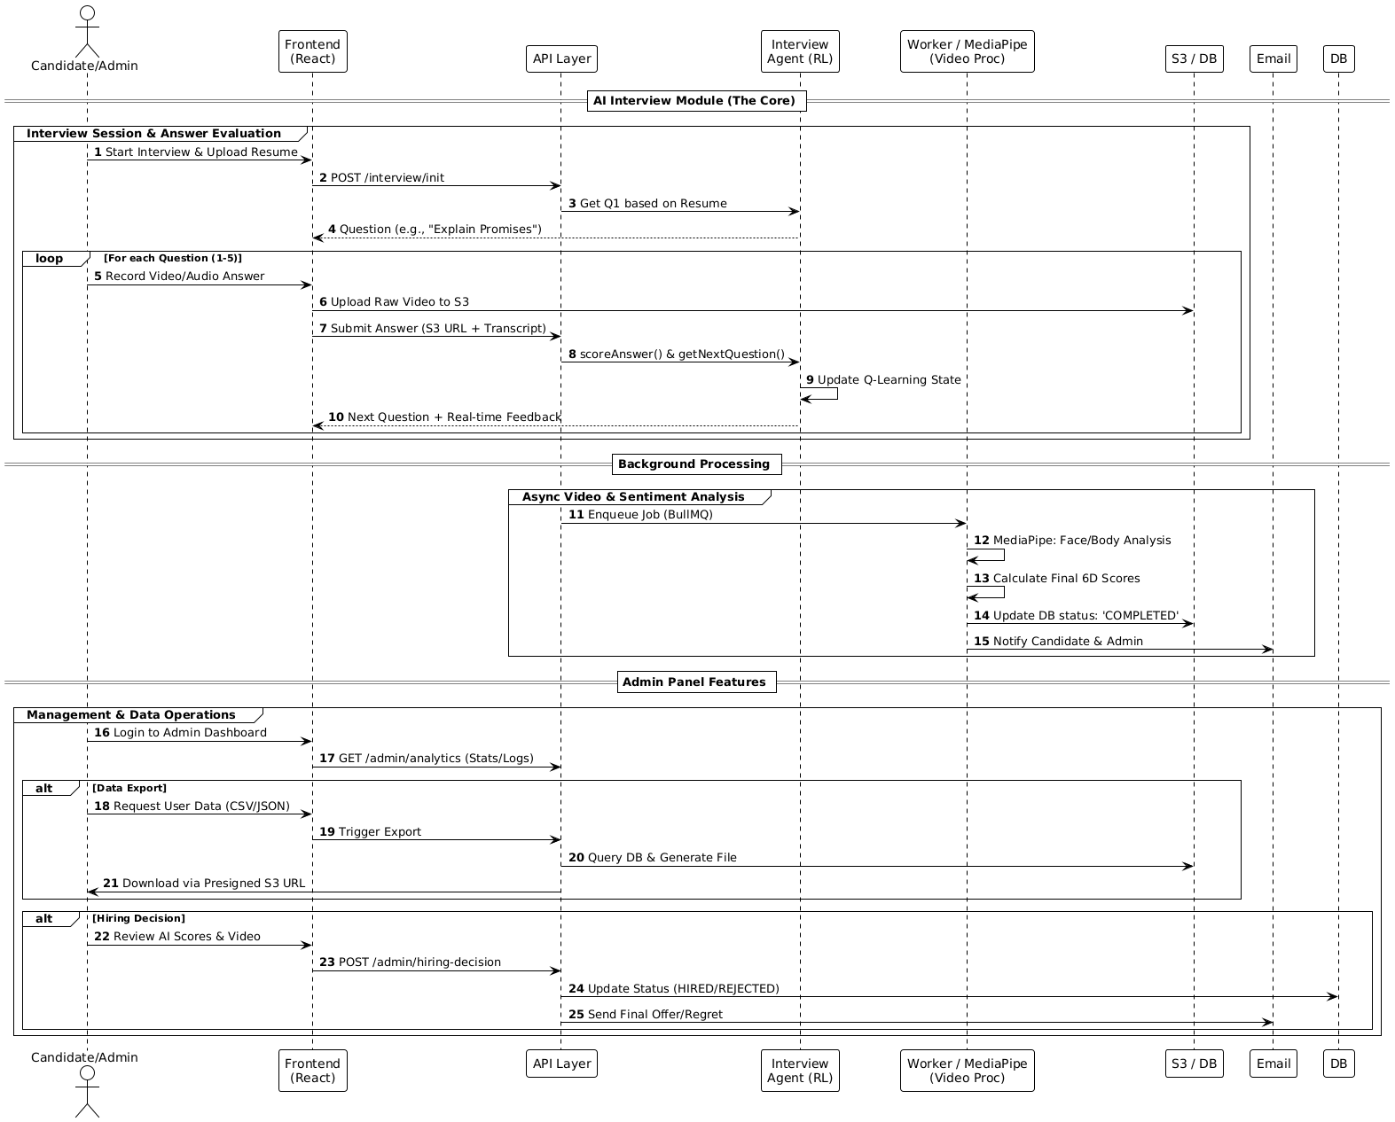
  Admin Sequence Diagram:

Slide 19
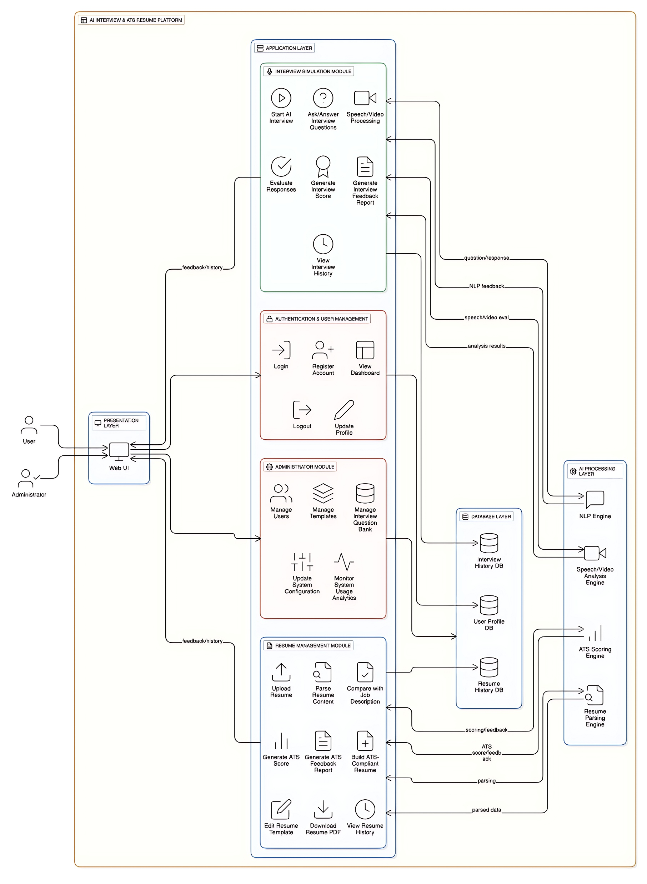
  System Architecture:

Slide 20
Implementation
  The system was implemented as an end-to-end full-stack platform, covering application development, AI model training, deployment, and production operations.
  A monorepo architecture was adopted, separating frontend, backend, AI training, infrastructure, and automation scripts.
  CI pipelines were configured for linting, unit testing, integration testing, container builds, and security vulnerability scans.
  CD pipelines supported staged deployments using canary and blue–green strategies with automated rollback on failure.
  Infrastructure utilized managed PostgreSQL, Redis, and object storage (S3) for persistence, caching, and media handling.
  Autoscaling groups, load balancers, and CDN integration enabled high availability and global traffic distribution.

Slide 21
  AI agents were trained offline using synthetic data generation pipelines to simulate large-scale hiring scenarios.
  Resume data passed through feature pipelines including parsing, normalization, TF-IDF/BM25 vectorization, and embedding generation.
  The Interview Agent was implemented using Q-Learning with discrete state quantization, ε-greedy exploration, and experience replay.
  ATS agents combined NLP feature extraction, reinforcement learning decision policies, and neural network validation models.
  Model artifacts were versioned with dataset identifiers, training parameters, and provenance metadata stored in object storage.
  Worker services handled video processing, speech-to-text transcription, MediaPipe-based facial analysis, and model inference.
  Security, monitoring, and operations were ensured through TLS encryption, RBAC, schema-level input validation, centralized logging, metrics monitoring, and automated backups.

Slide 22
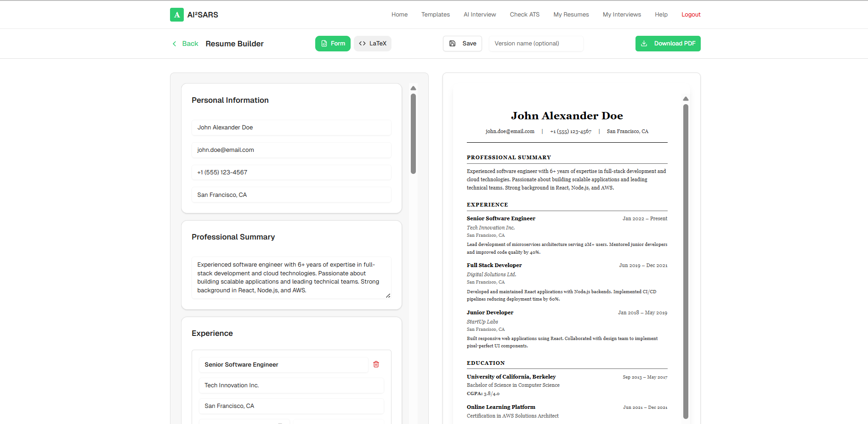
Result
  Resume Builder:

Slide 23
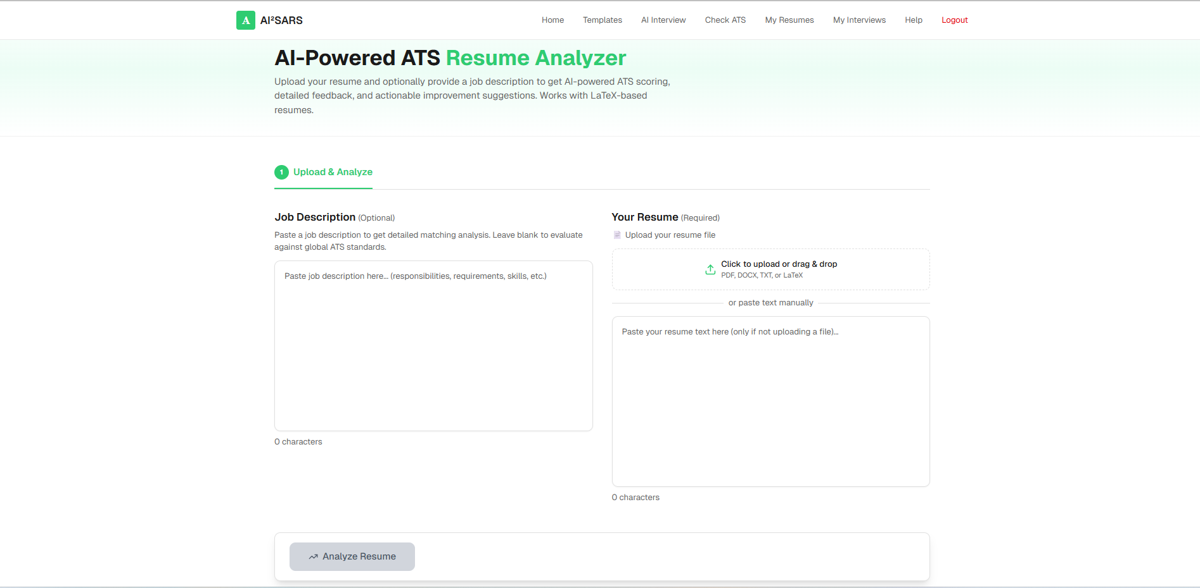
  ATS Machine:

Slide 24
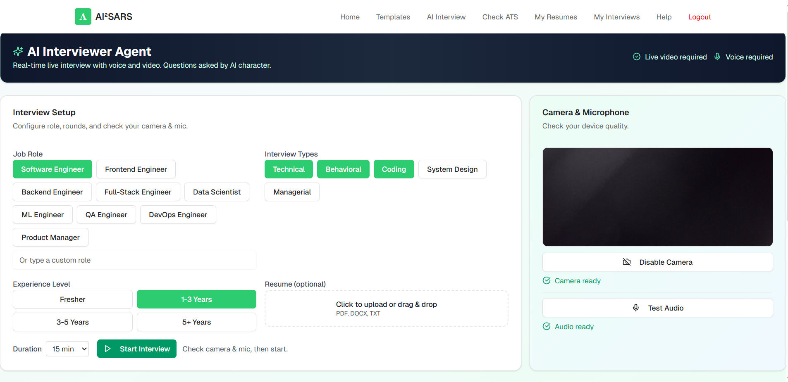
  AI Interview Module:

Slide 25
Conclusion
  The project successfully delivers an AI-enabled recruitment system integrating interview simulation and ATS evaluation within a unified platform.
  A multi-agent architecture was implemented comprising one Q-Learning interview agent (87,846 states, 2.5+ billion question combinations) and three collaborative ATS agents.
  The ATS agent ensemble achieved 94.7% hiring decision accuracy through coordinated reinforcement learning and neural network–based evaluation.
  The system consistently maintained sub-10 millisecond response latency, demonstrating nearly 100× performance improvement over cloud-based AI solutions.
  Complete elimination of external AI services enabled zero per-operation cost, unrestricted scalability, and full algorithmic control.
  Enterprise-grade security was ensured through OWASP Top 10 mitigation, encrypted communication, strong authentication, and regulatory compliance

Slide 26
                Thank You!

Slide 27
                Any Queries?

